Slide 1
IEEE 802

Slide 2
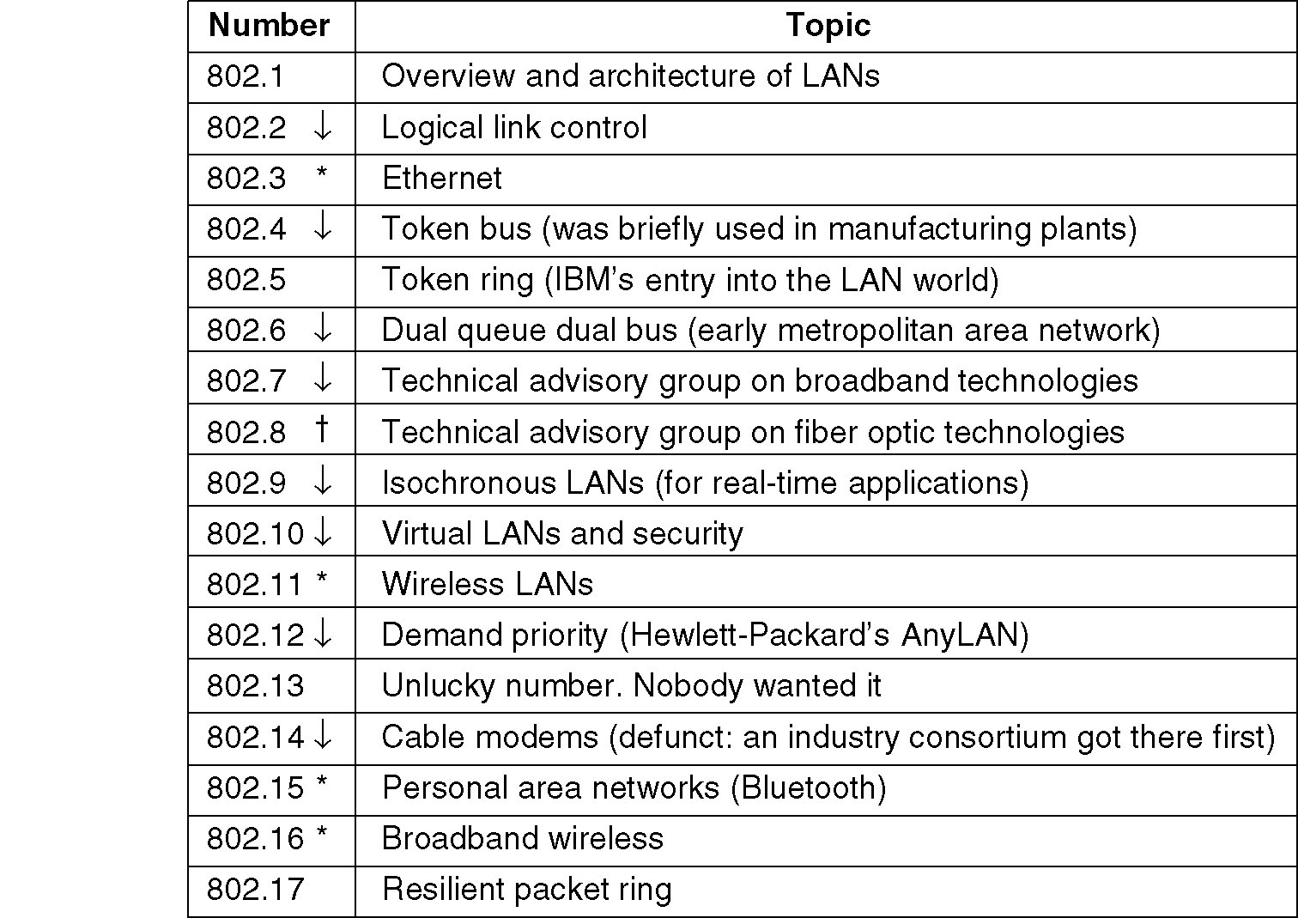
IEEE 802 Standards Working Groups
The important ones are marked with *. The ones marked with ↓ are hibernating. The one marked with † gave up.

Slide 3
CSMA/CD (IEEE 802.3 – Ethernet)
As in 1-persistent CSMA, but uses slotted channels
If medium idle, transmit
If busy, listen for idle slot, then transmit
In regular CSMA, collision occupies medium for duration of transmission
it is inefficient to complete the transmission of a collided packet
In CSMA/CD, stations listen while transmitting
If collision detected (due to high voltage on bus), cease transmission and wait random time then start again
random waiting time is determined using binary exponential backoff mechanism

Slide 4
CSMA/CD - Details of Contention
No acknowledgments in CSMA/CD, so sending station must make sure that:
all other stations are aware of its transmission and
there is no collision on the channel
so the sending station has to continue transmission for a duration of the worst case scenario in which understanding a collision takes as long as the round trip time
this is closely related to the length of the cable (bus) and the propagation speed
for 2500 meters of coax cable (standard for 10 Mbps Ethernet), round trip time is approx 50 microseconds

Slide 5
Minimum Frame Size
at 10 Mbps: one bit takes 100 ns to be transmitted
In order to occupy the channel during 50 microsecs
one frame at minimum should be 500 bits
plus some safety margins and rounding, minimum frame size is set to 512 bits (64 bytes) in IEEE 802.3
Maximum frame size is 1518 bytes
In TCP/IP world the encapsulation of IP datagrams is defined in RFC 894 for Ethernets and in RFC 1042 for IEEE 802 networks

Slide 6
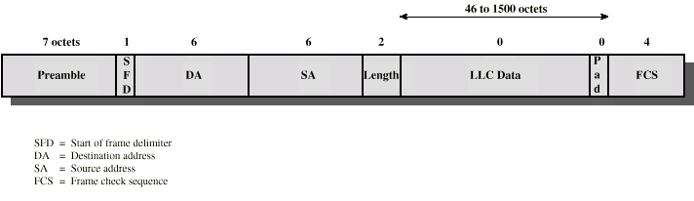
IEEE 802.3 Frame Format
>=
>=
Preamble is alternating 1’s and 0’s (for clock synchronization)
SFD is 10101011
Length is of the LLC data
FCS is 32-bit CRC (Cyclic Redundancy Check) code and excludes Preamble and SFD
Addresses are uniquely assigned by IEEE to manufacturers.

Slide 7
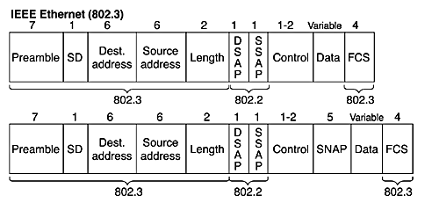
Preamble
SD: Start of frame Delimiter
Destination MAC address
Unicast
Broadcast
Multicast
Source address
Length – total number of bytes following
excluding CRC at the end
DSAP SSAP,
Control
SNAP (Subnet Network Access Protocol)
Data
Frame Check Sequence (FCS)

Slide 8
CSMA/CD Performance
Formulation for utilization
utilization = transmission time / (trans. time + all other)
If no collisions ➔ U = T_{trans} / (T_{trans} + T_{prop})
With collisions ➔ U = T_{trans} / (T_{trans} + T_{prop} + T_{contention})
T_{contention} is the time spent for collisions to send a frame

Slide 9
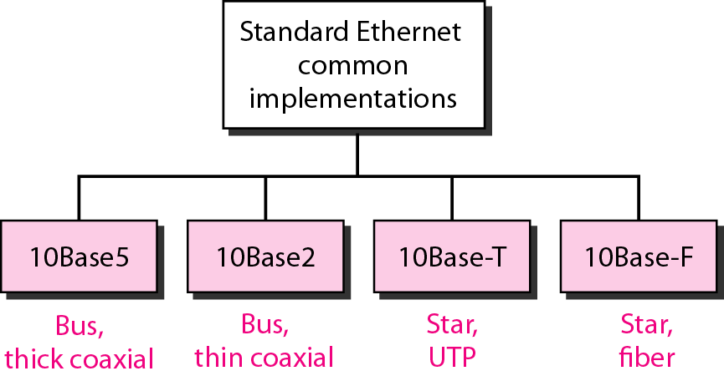

Slide 10
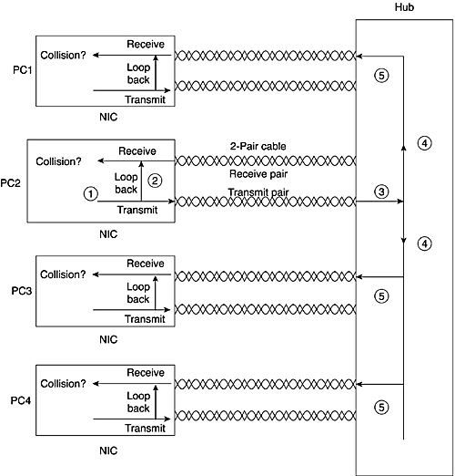
Ethernet Networking with a Hub
Half-Duplex 10BaseT
The network interface card (NIC) sends a frame.
The NIC loops the sent frame onto its receive pair.
The hub receives the frame.
The hub sends the frame across an internal bus so that all other NICs can receive the electrical signal.
The hub repeats the signal to each receive pair to all other devices.

Slide 11
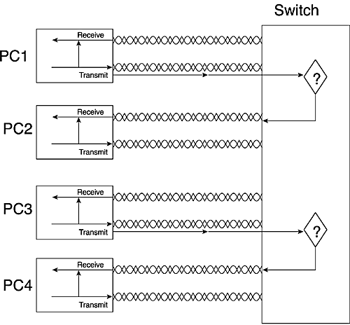
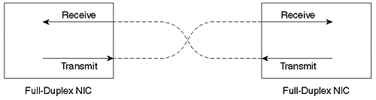
Ethernet Networking with a Switch
Full Duplex Ethernet
Full-duplex means that an Ethernet card can send and receive concurrently.
Use a switch or direct connection from host to using a crossover cable.
The switch interprets the electrical signal as an Ethernet frame and processes the frame to make a decision.
Hub – Layer 1
Switch – Layer 2

Slide 12
Basic Ethernet Features
10Base2, 10Base5 | Single bus cabled serially between devices using coaxial cable.
10BaseT with a Hub | One electrical bus shared among all devices creating a single collision domain, cabled in a star topology using twisted-pair cabling
10BaseT with a Switch | One electrical bus per switch port creating multiple collision domains, cabled in a star topology using twisted-pair cabling
Half Duplex | Logic that requires a card to only send or receive at a single point in time. Used to avoid collisions
Full Duplex | Logic that enables concurrent sending and receiving, allowed when one device is attached to a switch port, ensuring that no collisions can occur.

Slide 13
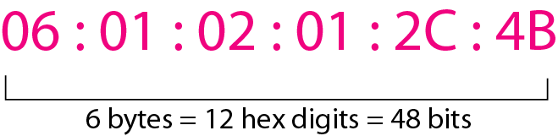
Ethernet Addressing
Ethernet uses MAC address burned into each NIC.
48 bits (6 bytes)
First 3 bytes assigned by IEEE
Unicast MAC Address
Broadcast MAC Address (FFFF.FFFF.FFFF)
Multicast Address
The least significant bit of the first byte defines the type of address. If the bit is 0, the address is unicast; otherwise, it is multicast.
The broadcast destination address is a special case of the multicast address in which all bits are 1s.

Slide 14
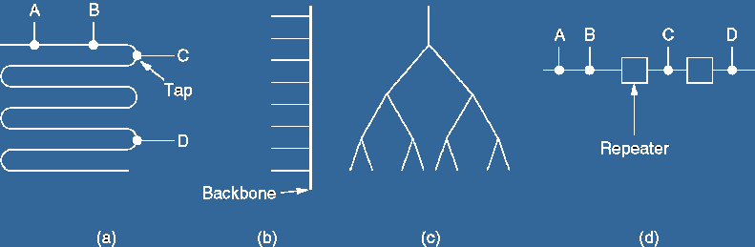
Cable topologies
Linear Spine (bus) Tree Segmented

Slide 15
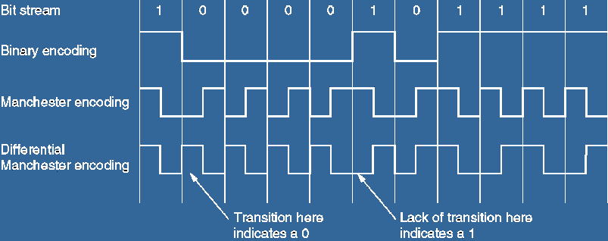
Manchester encoding

Slide 16
Summary of Standard Ethernet implementations

Slide 17
FAST ETHERNET
Fast Ethernet was designed to compete with LAN protocols such as FDDI or Fiber Channel.
IEEE created Fast Ethernet under the name 802.3u.
Fast Ethernet is backward-compatible with Standard Ethernet, but it can transmit data 10 times faster at a rate of 100 Mbps.

Slide 18
Fast Ethernet
100 Mbps bandwidth
Uses same CSMA/CD media access protocol and packet format as in Ethernet.
100BaseTX (UTP) and 100BaseFX (Fiber) standards
Physical media :-
100 BaseTX - UTP Cat 5e
100 BaseFX - Multimode / Singlemode Fiber
Full Duplex/Half Duplex operations.

Slide 19
Fast Ethernet
LAN Technologies
Provision for Auto-Negotiation of media speed:
10 Mbps or 100Mbps (popularly available for copper media only).
Maximum Segment Length
100 Base TX - 100 m
100 Base FX - 2 Km (Multimode Fiber)
100 Base FX - 20 km (Singlemode Fiber)

Slide 20
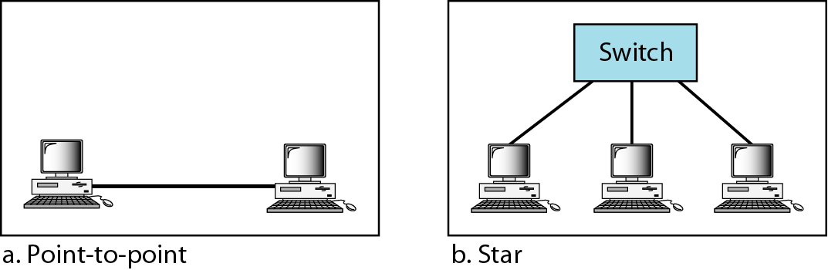
Fast Ethernet topology

Slide 21
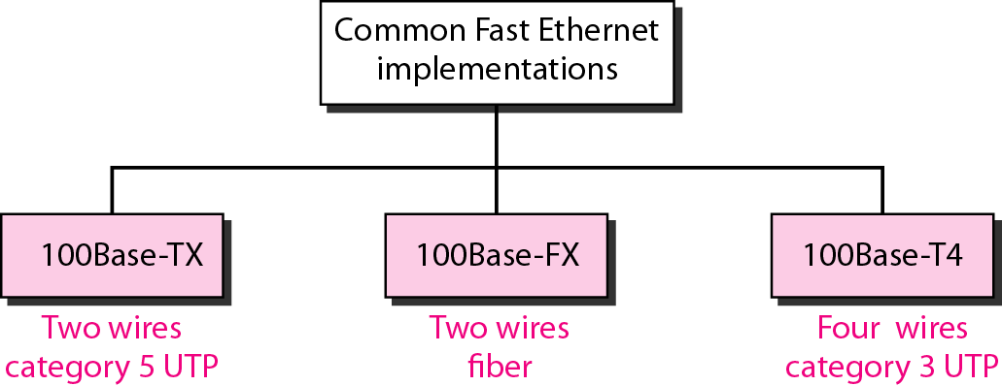
Fast Ethernet implementations

Slide 22
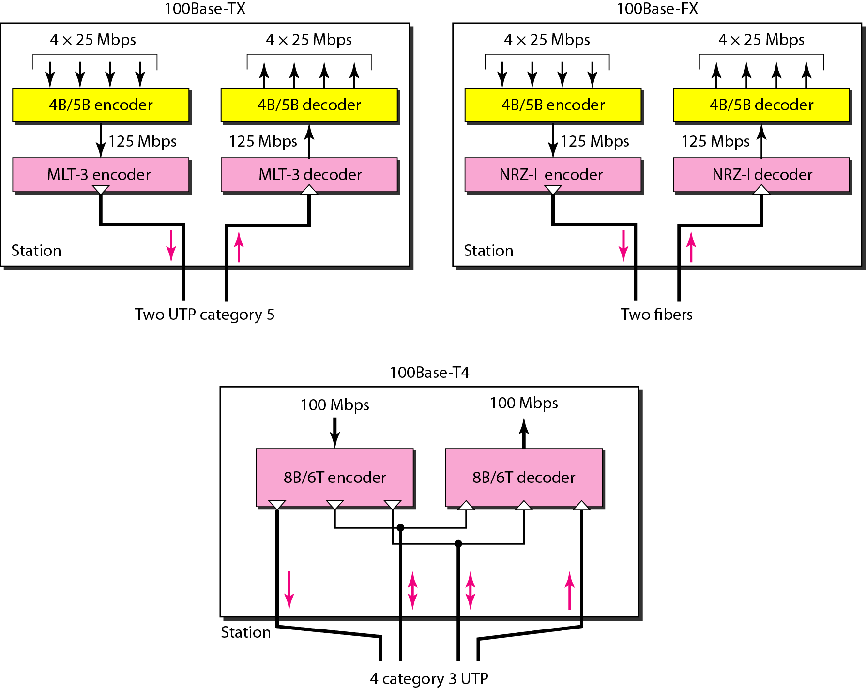
Encoding for Fast Ethernet implementation
MLT -3 Multi Level transmit , three voltage levels
4B/5B – maps group of 4 bits of data onto groups of 5 bits for transmission
NRZ- I Non return to Zero Inverted
8B/6T – 8 data bits as six ternary(one of three voltage level) signals

Slide 23
Summary of Fast Ethernet implementations

Slide 24
GIGABIT ETHERNET
The need for an even higher data rate resulted in the design of the Gigabit Ethernet protocol (1000 Mbps).
The IEEE committee calls the standard 802.3z.

Slide 25
Gigabit Ethernet
LAN Technologies
1 Gbps bandwidth.
Uses same CSMA/CD media access protocol as in Ethernet and is backward compatible (10/100 modules are available).
1000BaseT (UTP), 1000BaseSX (Multimode Fiber) and 1000BaseLX (Multimode/Single mode Fiber) standards.
Maximum Segment Length
1000 Base T - 100m (Cat 5e/6)
1000 Base SX - 275 m (Multimode Fiber)
1000 Base LX - 512 m (Multimode Fiber)
1000 Base LX - 20 Km (Single mode Fiber)
1000 Base LH - 80 Km (Single mode Fiber)

Slide 26
In the full-duplex mode of Gigabit Ethernet, there is no collision;
the maximum length of the cable is determined by the signal attenuation in the cable.

Slide 27
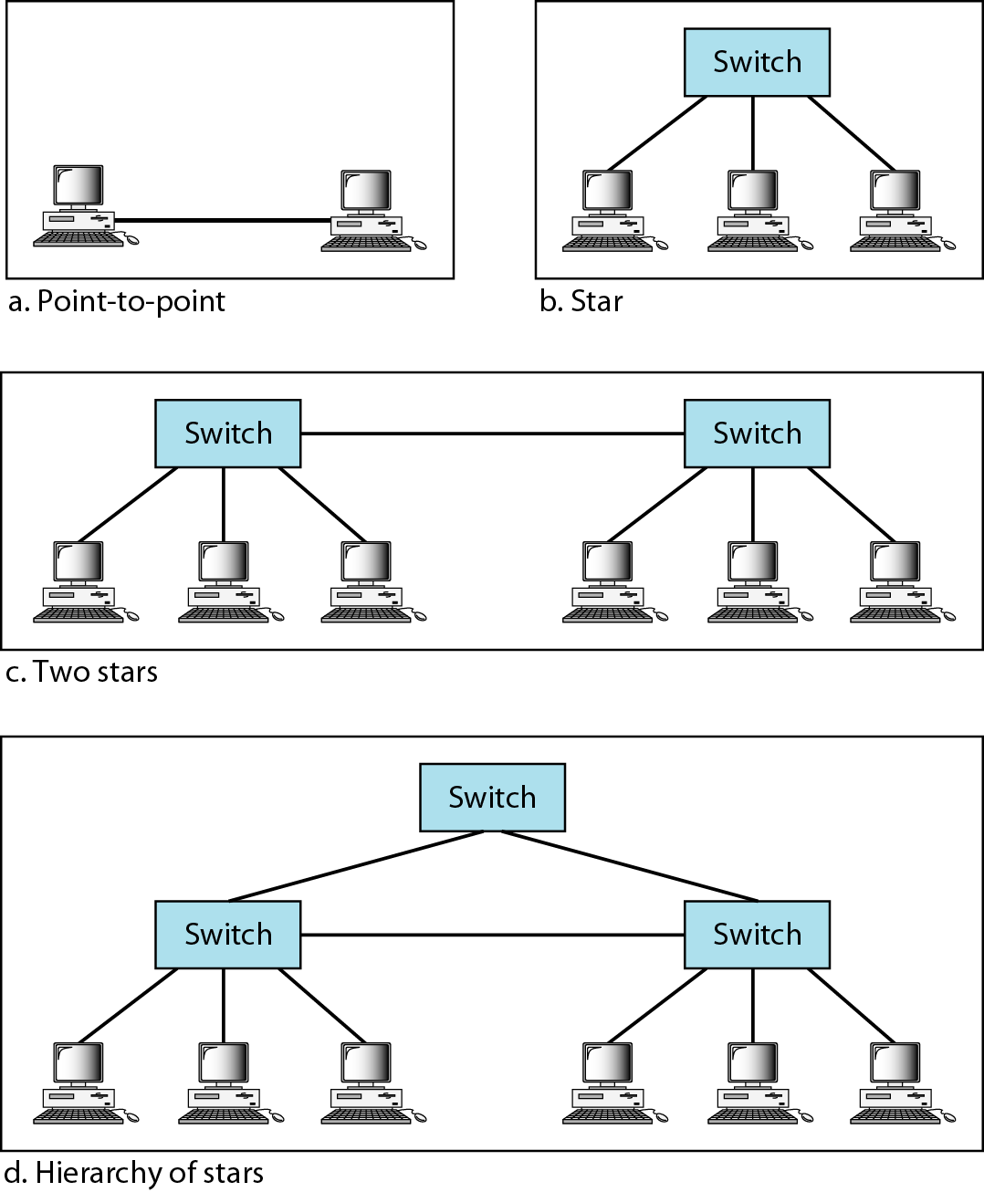
Topologies of Gigabit Ethernet

Slide 28
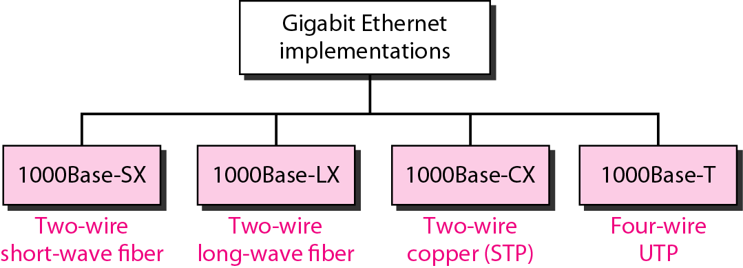
Gigabit Ethernet implementations

Slide 29
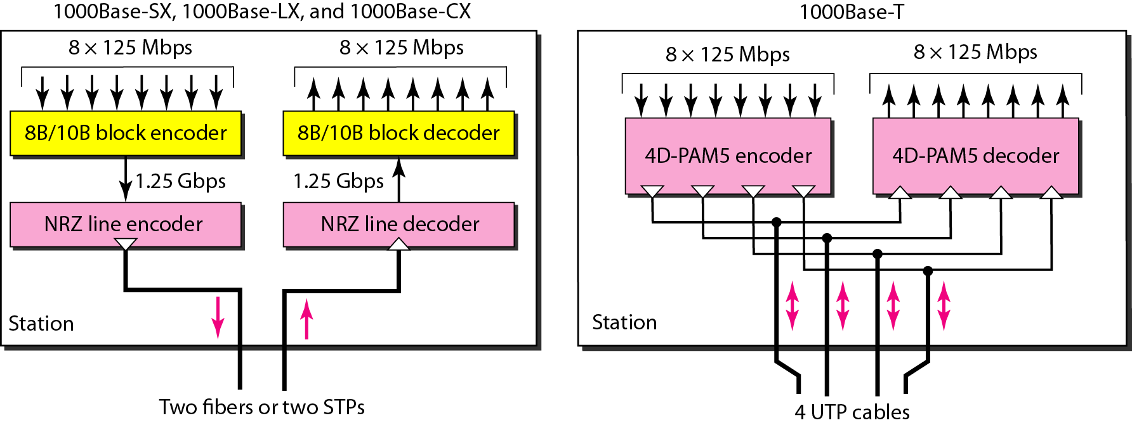
Encoding in Gigabit Ethernet implementations
8B/10B 8-bit words to 10 bits symbols
4D-PAM5 -four dimensional quinary symbols - 5-level (quinary) pulse amplitude modulation (PAM5)

Slide 30
Summary of Gigabit Ethernet implementations

Slide 31
10 Gigabit Ethernet
LAN Technologies
10 Gbps bandwidth.
Uses same CSMA/CD media access protocol as in Ethernet.
Propositioned for Metro-Ethernet
Maximum Segment Length
1000 Base-T - Not available
10GBase-LR - 10 Km (Singlemode Fiber)
10GBase-ER - 40 Km (Singlemode Fiber)

Slide 32
Summary of Ten-Gigabit Ethernet implementations
Encoding used 64b/66b - line code that transforms 64-bit data to 66-bit line code

Slide 33
Token Bus – IEEE 802.4
A network which implements the modified Token Ring protocol over a "virtual ring" on a coaxial cable with a bus topology.
It is mainly used for industrial applications.
1
1
1
1
1

Slide 34
Token Bus – IEEE 802.4
Token Bus (IEEE 802.4) is a standard for implementing token ring over the virtual ring in LANs.
The physical media has a bus or a tree topology and uses coaxial cables.
A virtual ring is created with the nodes/stations and the token is passed from one node to the next in a sequence along this virtual ring - Logical ordering of all stations to form a ring
Each node knows the address of its preceding station and its succeeding station.
All stations are treated equally
A station can only transmit data when it has the token.

Slide 35
Token Bus - Ring Organisation
Linear tree shaped cable on to which stations are attached.
Each station knows the address of its left and right neighbours.
Stations are organized as a circular doubly-linked list
Ring is first initialised
coordinator to initialise ring.
stations inserted in the order of station address

Slide 36
Token Bus
A distributed polling algorithm is used to avoid bus contention
Token: Right of access
Token passing from higher to lower order station address
Token acquired station transmits for certain amount of time
Hand over token either at end of time or no frame to transmit
prioritize tokens
each node maintains a queue of frames
each node has timers
handover token from higher priority to lower priority.
fraction of token holding time allocated to each priority.
useful for implementing real – time traffic.

Slide 37
Token Holder (The station receiving the token)
Transmit one or more MAC-frame
Poll other stations
Receive responses
Non-Token Holder
Listen to the channel
Respond to a poll
Send Acknowledgement
Logical Ring Maintenance
Ring Initialization
Addition to ring
Deletion from ring
Error Recovery

Slide 38
Token Bus Frame Format
Preamble: 1 byte for synchronization.
Start Delimiter: 1 byte that marks the beginning of the frame.
Frame Control: 1 byte that specifies whether this is a data frame or control frame.
Destination Address: 2-6 bytes that specifies address of destination station.
Source Address: 2-6 bytes that specifies address of source station.
Payload: A variable length field that carries the data from the network layer.
Checksum: 4 bytes frame check sequence for error detection.
End Delimiter: 1 byte that marks the end of the frame.

Slide 39
Message Exchange in Token Bus
Two Types of messages are used
Token message T_{ID, nextID}
Data message M_{ID}
Token messages are used for passing on the sending permission from station ID to Station nextID.
Data messages contain the data to be sent
Having the token, a station is allowed to send a message. After this (or if nothing is to be sent) the token is passed on.
ID | nextID
ID | Data

Slide 40
Traffic on the bus e.g.
T_{5,17} -> M₁₇ -> T_{17,21} -> M₂₁ -> T_{21,22}-> T_{22,42 ->} T_{42, 63} -> M₆₃ -> T_{63, 149} -> T_{149, 5} -> M₅ -> T_{5,17} -> …..
High overhead for token exchange : 512 bit times for each token message ( a full small size Ethernet frame). In contrast to that, in Token Ring networks only one bit is to be switched from 0 to 1, i.e. only one bit time for a token message.
Thus the number of participating stations should be low or the number of masters should be low and many number of slaves can be tolerated.

Slide 41
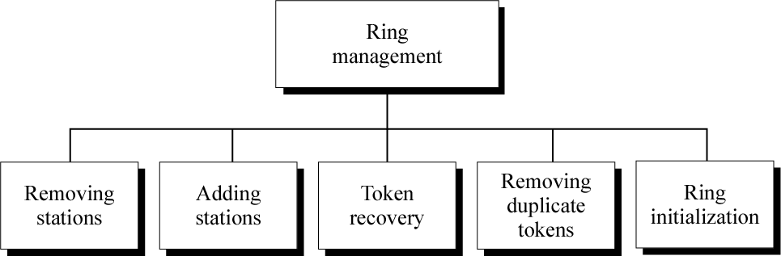
Ring Management

Slide 42
Problems with Token Bus
First problem:
A station leaves the logical ring
Solution: The leaving station sends a message to its predecessor indicating the new successor.
Second Problem: A station joins the logical ring:
To allow new stations to join, in periodically interval, a window is opened between neighbors, e.g. between 5 and 17.
New stations with IDs from 6 to 16 can apply.
Problem: Conflict risk. More than one station could apply to join in this window.
Conflict Resolution: Survival of the fittest. Consider last 2 bits of the IDs:
Send a request to join with a duration specified by the last 2 bits of the ID:
00 send short
01 send long
10 send longer
11 send longest
A station gives up If some station is sending longer than its own. If no conflict occurs, then the station joins. If there is no resolution, then the second last bit pair is considered.

Slide 43
Token Ring – IEEE 802.5
A ring topology network developed in the late 1960s. Supported mainly by IBM. pushed into the background by Ethernet in the 1990s.
a LAN protocol which resides at the data link layer (DLL) of the OSI model.

Slide 44
Topology – Ring topology
Transmission – Unidirectional
Encoding – Differential Manchester encoding
Access control – Token passing
Data rates – 4 Mbps, 16 Mbps
Token ring imposes no lower bound on size of data

Slide 45
Sending and receiving

Slide 46
Token Ring frame formats
Data or command frame
SD | AC | FC | DA | SA | PDU from LLC (IEEE 802.2) | CRC | ED | FS
8 bits | 8 bits | 8 bits | 48 bits | 48 bits | up to 18200x8 bits | 32 bits | 8 bits | 8 bits
Token
Abort frame
SD | AC | ED
8 bits | 8 bits | 8 bits
SD | ED
8 bits | 8 bits
SD: Starting delimiter J K 0J K 0 0 J, K are non data symbols, Line codes
AC: Access control PPPTMRRR P- Priority, T- Token bit, M- Monitor bit, R – Reservation bit
FC: Frame control FF ZZZ ZZZ FF – frame Type , Z – control bits
DA: Destination address
SA: Source address
PDU: data
CRC: check sum
ED: End delimiter JK1JK1 IE I Intermediate frame bit, E – Error detection bit
FS: Frame status A C xx AC xx , A Address recognized bit, C frame copied, xx undefined bit

Slide 47
Frame Status contains confirmation bits A and C.
If a frame arrives at the station with the destination address, bit A is set.
If the station processes the frame, then bit C also is set. When the sending station gets the frame back, it can see whether the receiving station is not working ( A=0, C=0). If the frame was not accepted (A=1, C=0) or whether the frame was received correctly (A=1, C =1).
To protect against bit errors, both bits are doubly present.
The addresses and the checksum are identical to Ethernet.

Slide 48
Bits of access control:
The priority bits make possible several priorities. They indicate the priority of the token. If a station wants to send with priority n, it must wait for a token of priority n or higher.
Token bit is used to indicate presence of token frame. If token bit = 1 –> token frame and if token bit = 0 –> not a token frame.
The monitor bit serves for recognition of a second frame circulation i.e. helps in solving orphan packet problem.
The reservation bits permit a station to reserve the next frame for itself. If a station wants to do this, it registers its priority into reservation bits. This is only possible if not already a higher priority is registered. During the next token generation, the priority is copied into the priority bits

Slide 49
Token Ring operation
When nobody is transmitting a token circles.
When a station needs to transmit data, it converts the token into a data frame.
When the sender receives its own data frame, it converts the frame back into a token.
If an error occurs and no token frame, or more than one, is present, a special station (“Active Monitor”) detects the problem and removes and/or reinserts tokens as necessary.
The Abort frame: used to abort transmission by the sending station.

Slide 50
Active and Standby monitors
Every station in a token ring network is either an Active monitor (AM) or Standby monitor (SM) station. There can be only one active monitor on a ring at a time. The active monitor is chosen through an election or monitor contention process.
The monitor contention process is initiated when
A loss of signal on the ring is detected,
An AM station is not detected by other stations, or
When a timer on an end station expires (the station hasn't seen a token in the past 7 seconds).
When any of the above conditions take place and a station decides that a new AM is needed.
The AM performs a number of ring management functions and roles:
Master clock for the ring, synchronization.
Inserts a 24-bit delay into the ring for sufficient buffering.
To support exactly one token and there is no frame being transmitted.
Detects a broken ring.
Removes circulating frames from the ring.

Slide 51
Ring Maintenance
To check the correct function of the ring, a monitor station is introduced.
If this station crashes, another station is raised as another station is raised as monitor station.
If a station recognizes that the monitor is inactive, this station sends a CLAIM_TOKEN. This can be done by several stations simultaneously.
If such a message arrives with a smaller ID then suppress it.
If a message arrives with a Larger ID then pass it on.
If a CLAIM_TOKEN message arrives with own ID: then that station is the new monitor.
Tasks of the monitor station:
New generation of the token after a token loss.
Reaction to ring collapse
Removal of frame fragments
Deletion of old, circulating frames.
For each problem an own token is defined. If necessary timers are also used.

